Slide 1
PRESENTATION
ON
“AUGMENTED REALITY”
By
S.Vishwanatha Naik
S.Vishwanatha Naik 28587

Slide 2
Topics To Discuss
Augmented Reality
Augmented Reality System
How it Works
Display techniques
AR vs VR
Technology
Applications & Examples
Disadvantages and Conclusion
Reference
S.Vishwanatha Naik 28587
Notes:
S.VISHWANATHA NAIK

Slide 3
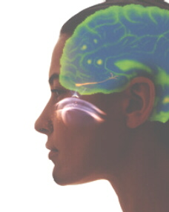
What is Augmented Reality?
A combination of a real scene viewed by a user and a virtual scene generated by a computer that augments the scene with additional information.
S.Vishwanatha Naik 28587
Notes:
Generates a composite view for the user.
S.VISHWANATHA NAIK

Slide 4
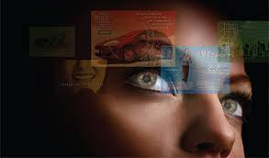
Feature of Augmented Reality
An AR system adds virtual computer-generated objects, audio and other sense enhancements to a real-world environment in real time.
S.Vishwanatha Naik 28587
Notes:
EXPLAIN FEATURE WITH EXAMPLE
S.VISHWANATHA NAIK

Slide 5
What is the Goal of AR?
To enhance a person’s performance and perception of the world
But, what is the ultimate goal????
S.Vishwanatha Naik 28587
Notes:
S.VISHWANATHA NAIK

Slide 6
The Ultimate Goal of AR
Create a system such that a user CANNOT tell the difference between the real world and the virtual augmentation of it.
S.Vishwanatha Naik 28587
Notes:
To the user of this system, it would appear that he is looking at a single scene.
Show image a few slides back:
Shows the merging and correct registration of pre-operative data
and the patient’s head.
Providing this view to a surgeon in the operating room would:
Enhance the surgeon’s performance
Possibly eliminate the need for any other calibration
fixtures during the operation
S.VISHWANATHA NAIK

Slide 7
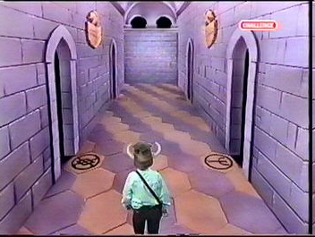
Milgram’s Reality-Virtuality Continuum
Mixed Reality (MR)
Real Environment
Augmented Reality (AR)
Augmented Virtuality (AV)
Virtual Environment
S.Vishwanatha Naik 28587
Notes:
Augmented reality is closest to the real world because mainly a user is perceiving
the real world with just a little computer generated data.
This distinction will probably fade as technology improves.
S.VISHWANATHA NAIK

Slide 8
Augmented Reality vs.
Virtual Reality
Augmented Reality
System augments the real world scene
User maintains a sense of presence in real world
Needs a mechanism to combine virtual and real worlds
Virtual Reality
Totally immersive environment
Visual senses are under control of system
Needs a mechanism to combine real world to user
S.Vishwanatha Naik 28587
Notes:
Computer generated virtual objects must be accurately registers with the real
in all dimensions.
Errors in registration prevent the real and virtual images from being seen as fused.
Registration must be maintained while the user moves around in the virtual
environment.
Changes in registration can be distracting or physically disturbing.
S.VISHWANATHA NAIK

Slide 9
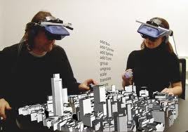
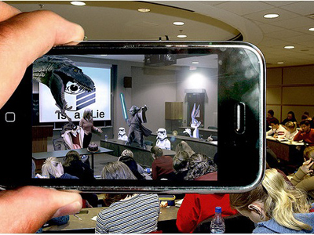
This is how AR works
Pick A Real World Scene
Add your Virtual Objects in it.
Delete Real World Objects
Not Virtual Reality since Environment Real.
S.Vishwanatha Naik 28587

Slide 10
Display Technologies
Monitor Based
Head Mounted Displays:
  Video see-through
  Optical see-through
S.Vishwanatha Naik 28587
Notes:
S.VISHWANATHA NAIK

Slide 11
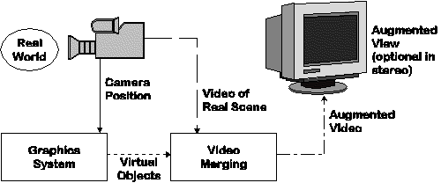
Monitor Based Augmented Reality
Simplest available
Little feeling of being immersed in environment
S.Vishwanatha Naik 28587
Notes:
Sometimes referred to as “Windows on the World” or “Fish Tank VR”
Other display technologies are used to increase the sense of presence.
S.VISHWANATHA NAIK

Slide 12
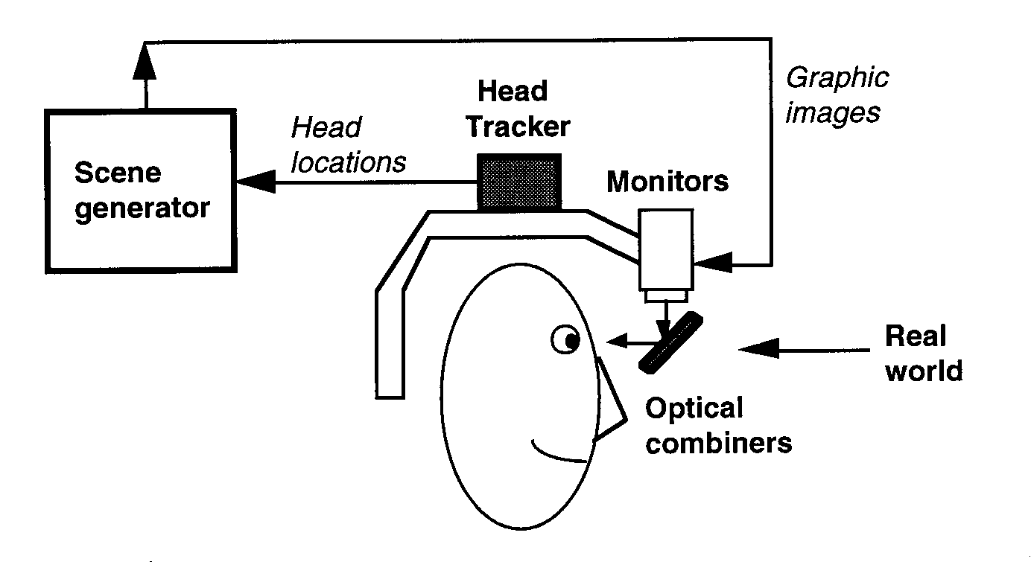
Optical see-through HMD
S.Vishwanatha Naik 28587
Notes:
Works by placing optical combiners in front of the user’s eyes.
Combiners are partially transmissive - so user can look directly through them
and see the real world.
Combiners are partially reflective - so user can also see virtual images bounced
off the combiners from head-mounted monitors.
Similar to Head-Up Displays (HUDs) commonly used in military aircraft.
Can see through the display even if the power is turned off.
S.VISHWANATHA NAIK

Slide 13
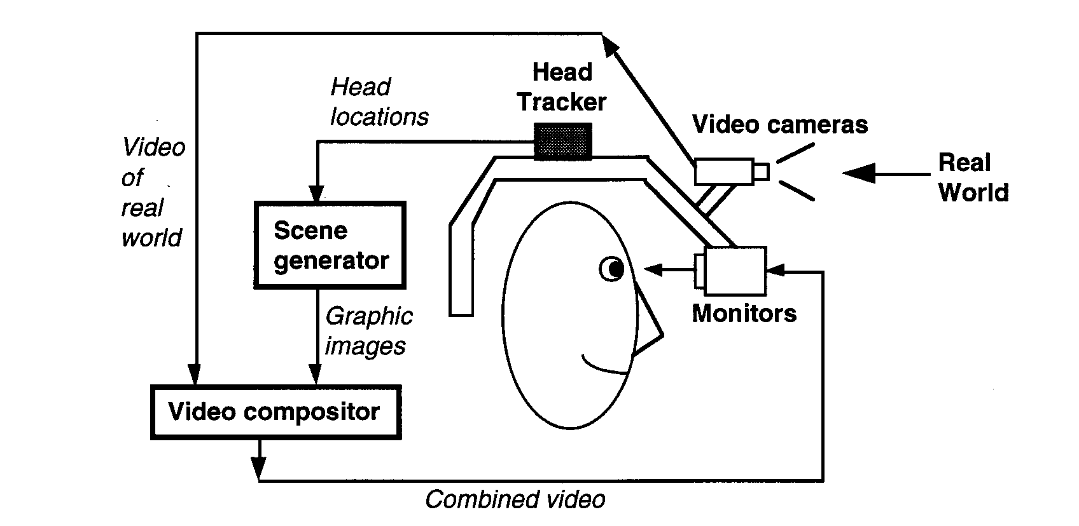
Video see-through HMD
S.Vishwanatha Naik 28587
Notes:
Works by combining a closed-view HMD with one or two head-mounted video
cameras
Video cameras provide the user’s view of the real world.
Video from cameras is combined with graphics images by the scene generator to
blend the two worlds.
Result is sent to the monitors in from on the user’s eyes in the closed-view HMD.
User has no direct view of the real world.
If power is off, the user is “blind.”
S.VISHWANATHA NAIK

Slide 14
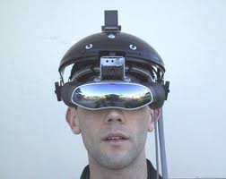
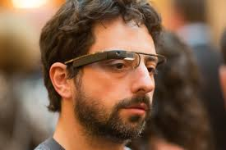
DISPLAY
Head-mounted Display(HMD)
  device paired to a headset such as a harness or helmet
Eye Glasses
  eye wear that employs cameras to intercept the real world view and re-display it's augmented view through the eye pieces
S.Vishwanatha Naik 28587

Slide 15
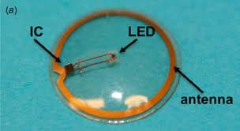
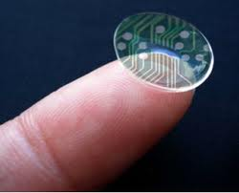
DISPLAY(cont..)
Contact Lenses
  Contain the elements for display embedded into the lens including integrated circuitry, LEDs and an antenna for wireless communication.
  Under development
Virtual Retinal Display
  a personal display device under development .
  a display is scanned directly onto the retina of a viewer's eye.
S.Vishwanatha Naik 28587

Slide 16
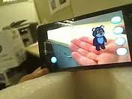
DISPLAY(cont..)
Handheld
  a small display that fits in a user's hand.
  Portable
  Ubiquitous
  Physical constraints of the user having to hold the device
  Distorting effect
Spatial
  makes use of digital projectors to display graphical information.
  user is not required to carry equipment or wear the display over their eyes.
  can be used by multiple people at the same time without each having to wear a head-mounted display.
S.Vishwanatha Naik 28587

Slide 17
Applications
Medical
Entertainment
Military Training
Engineering Design
Robotics and Telerobotics
Manufacturing, Maintenance, and Repair
Consumer Design
Audio
S.Vishwanatha Naik 28587
Notes:
S.VISHWANATHA NAIK

Slide 18
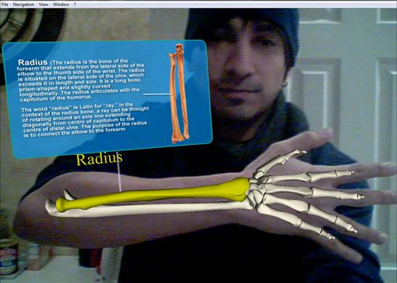

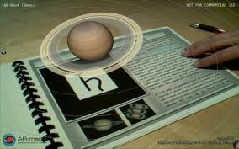
Medical
Education
S.Vishwanatha Naik 28587

Slide 19
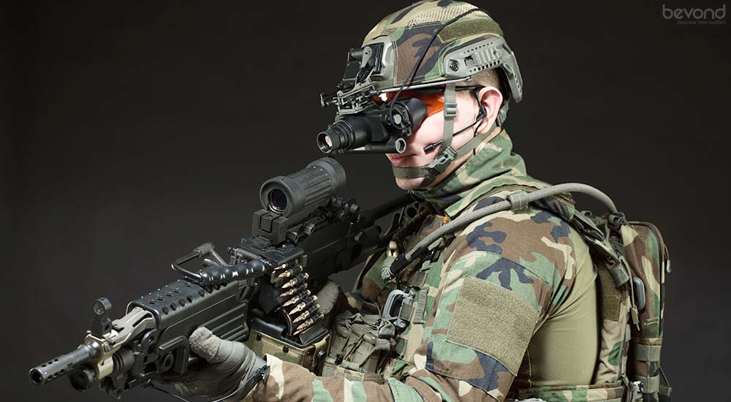

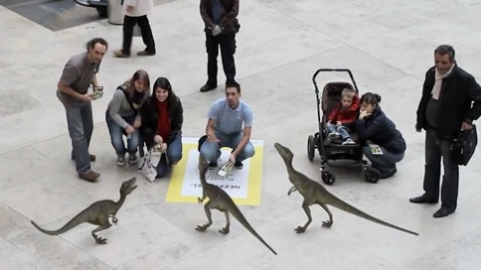
Military Training
Entertainment
S.Vishwanatha Naik 28587

Slide 20
Disadvantages of AR
Accuracy
  Large margin of error
Standards
  No open standards among AR browsers
Availability of AR-capable devices
  Smart phones only
S.Vishwanatha Naik 28587
Notes:
S.VISHWANATHA NAIK

Slide 21
Conclusion
AR is receiving attention due to the progress it has made in various subfields.
AR researchers work in areas such as signal processing, computer vision, graphics, user interfaces, human factors.
Augmented reality is a term created to identify systems which are synthetic such as mapping video onto virtual objects.
S.Vishwanatha Naik 28587

Slide 22
Reference
Graham, M., Zook, M., and Boulton, A. "Augmented reality in urban places: contested content and the duplicity of code." Transactions of the Institute of British Geographers, DOI: 10.1111/j.1475-5661.2012.00539.x 2012.
AR Timeline http://www.crystalinks.com/achtml
http://www.juniperresearch.com/press-release/augmented-reality-pr2 Mobile Augmented Reality Revenues. Last assessed 15th March 2015
http://sumo.N/lkvX via ABI Research Augmented Reality trends. Last assessed 15th March 2015
httpliwww.bbc.com/news/business-29077495 Online Retail Spending Forecasts by Forrester Research. Last assessed 15th March 2015
http://www.techn ologyreview.com/news/530336/furniture-shopping-with­augmented-real ity/
http://www.vizeralabs.com/
Consumer Behaviour Model on the Furniture Market, Eva BEDNARIK*—Judit PAKAINE KOVATS
Success factors for Augmented Reality Business Models, Nils van Kleef, Johan Noltes, Sjoerd van der Spoel
S.Vishwanatha Naik 28587

Slide 23

S.Vishwanatha Naik 28587

